Slide 1

A Project Presentation on Semantic Segmentation For Brain Tumour MRI Image Segmentation
Presented By Deepak Budhwani (1409713031) Himani Sharma (1409713044) Mansi Goyal (1409713055 )
Guided By Prof. Sanjay Kumar Astt. Professor Department of IT
GALGOTIAS COLLEGE OF ENGINEERING AND TECHNOLOGY
Dr.A P J Abdul Kalam Technical University,Lucknow,Uttar Pradesh

Slide 2

TABLE OF CONTENT
Introduction
Background
Problem Statement
Proposed Work
System Design
Implementation
Result
Conclusion
References

Slide 3



INTRODUCTION

Slide 4


Slide 5
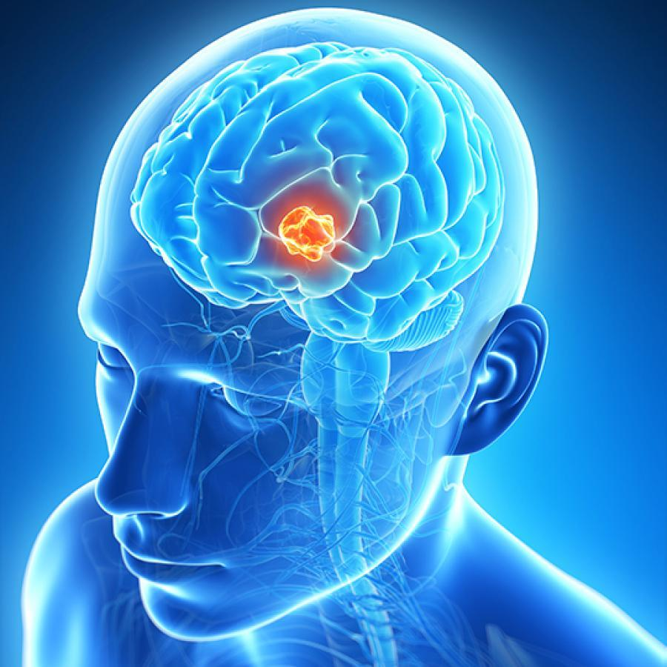
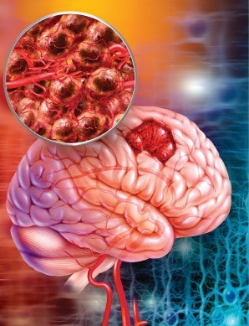
A mixed group of neoplasms originating from intracranial
tissues and the meninges with degrees of malignancy ranging from benign to aggressive.

Slide 6

Background Details:

Slide 7
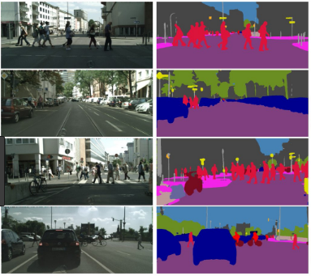
Semantic segmentation
The goal is to simplify and/or change the representation of an image into something that is more meaningful and easier to analyze.
used to locate objects and boundaries(lines, curves, etc.) in images
pixels with the same label share certain characteristics.

Slide 8
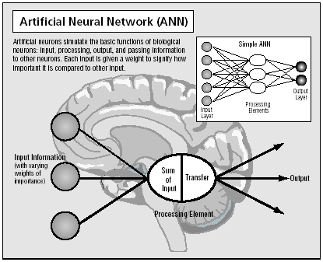

Slide 9
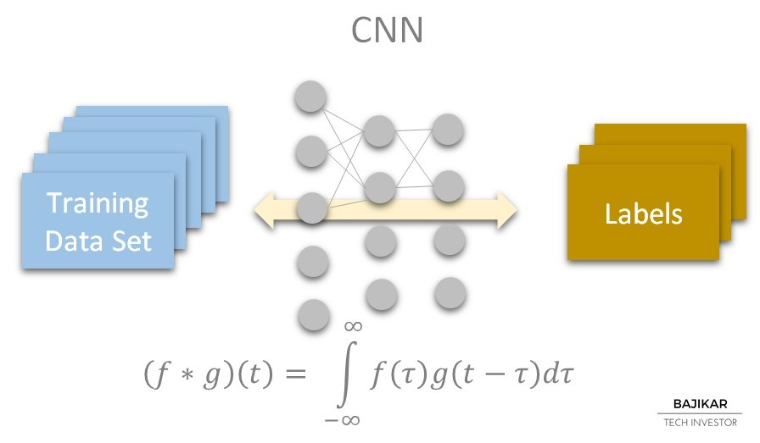
Simonyan and Zisserman proposed the use of small 3 3 kernels to obtain deeper CNNs.
a kernel, convolution matrix, or mask is a small matrix used for blurring,
sharpening, embossing, edge detection, and more.

Slide 10

Problem Statement

Slide 11
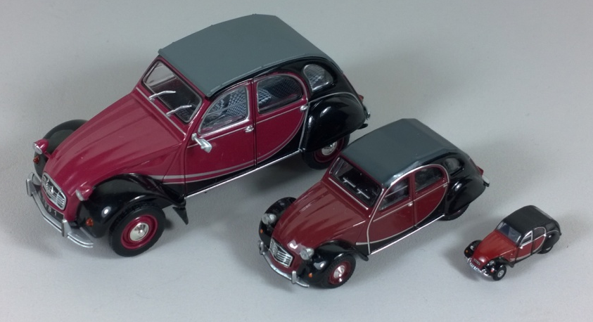
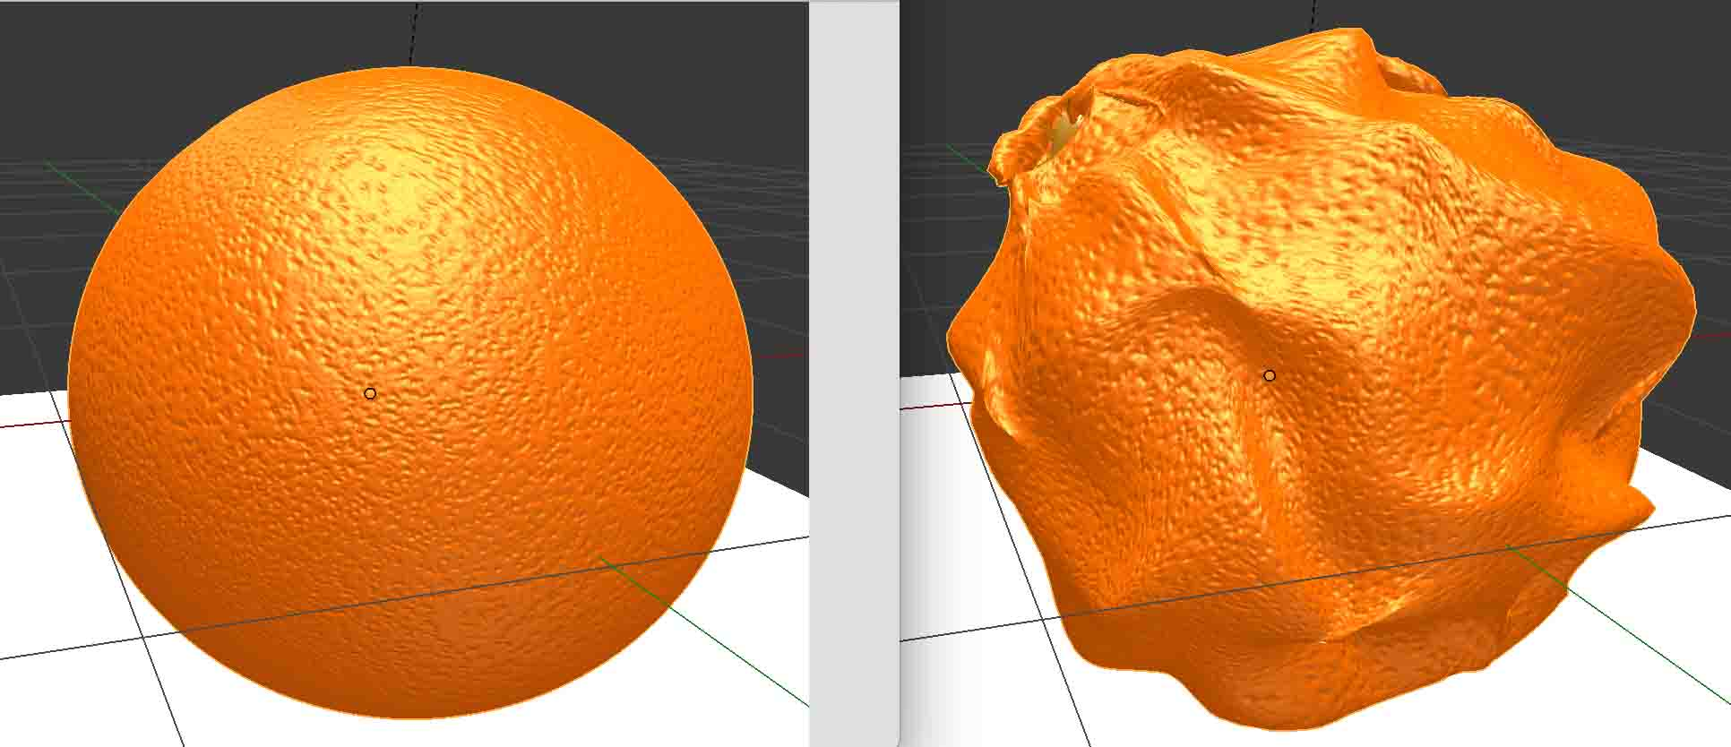
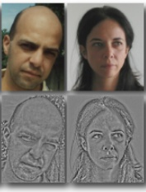
Scale variation- Visual classes often exhibit variation in their size(size in real world,not only in terms of their extent in the image)
Deformation- Many objects of interest are not rigid bodies and can be deformed in extreme ways.
Illumination condition- The effects of illumination are drastic on the pixel level.

Slide 12
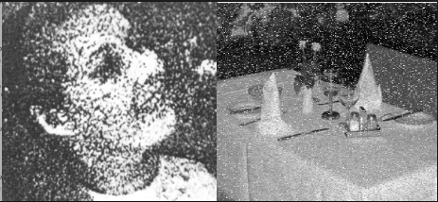
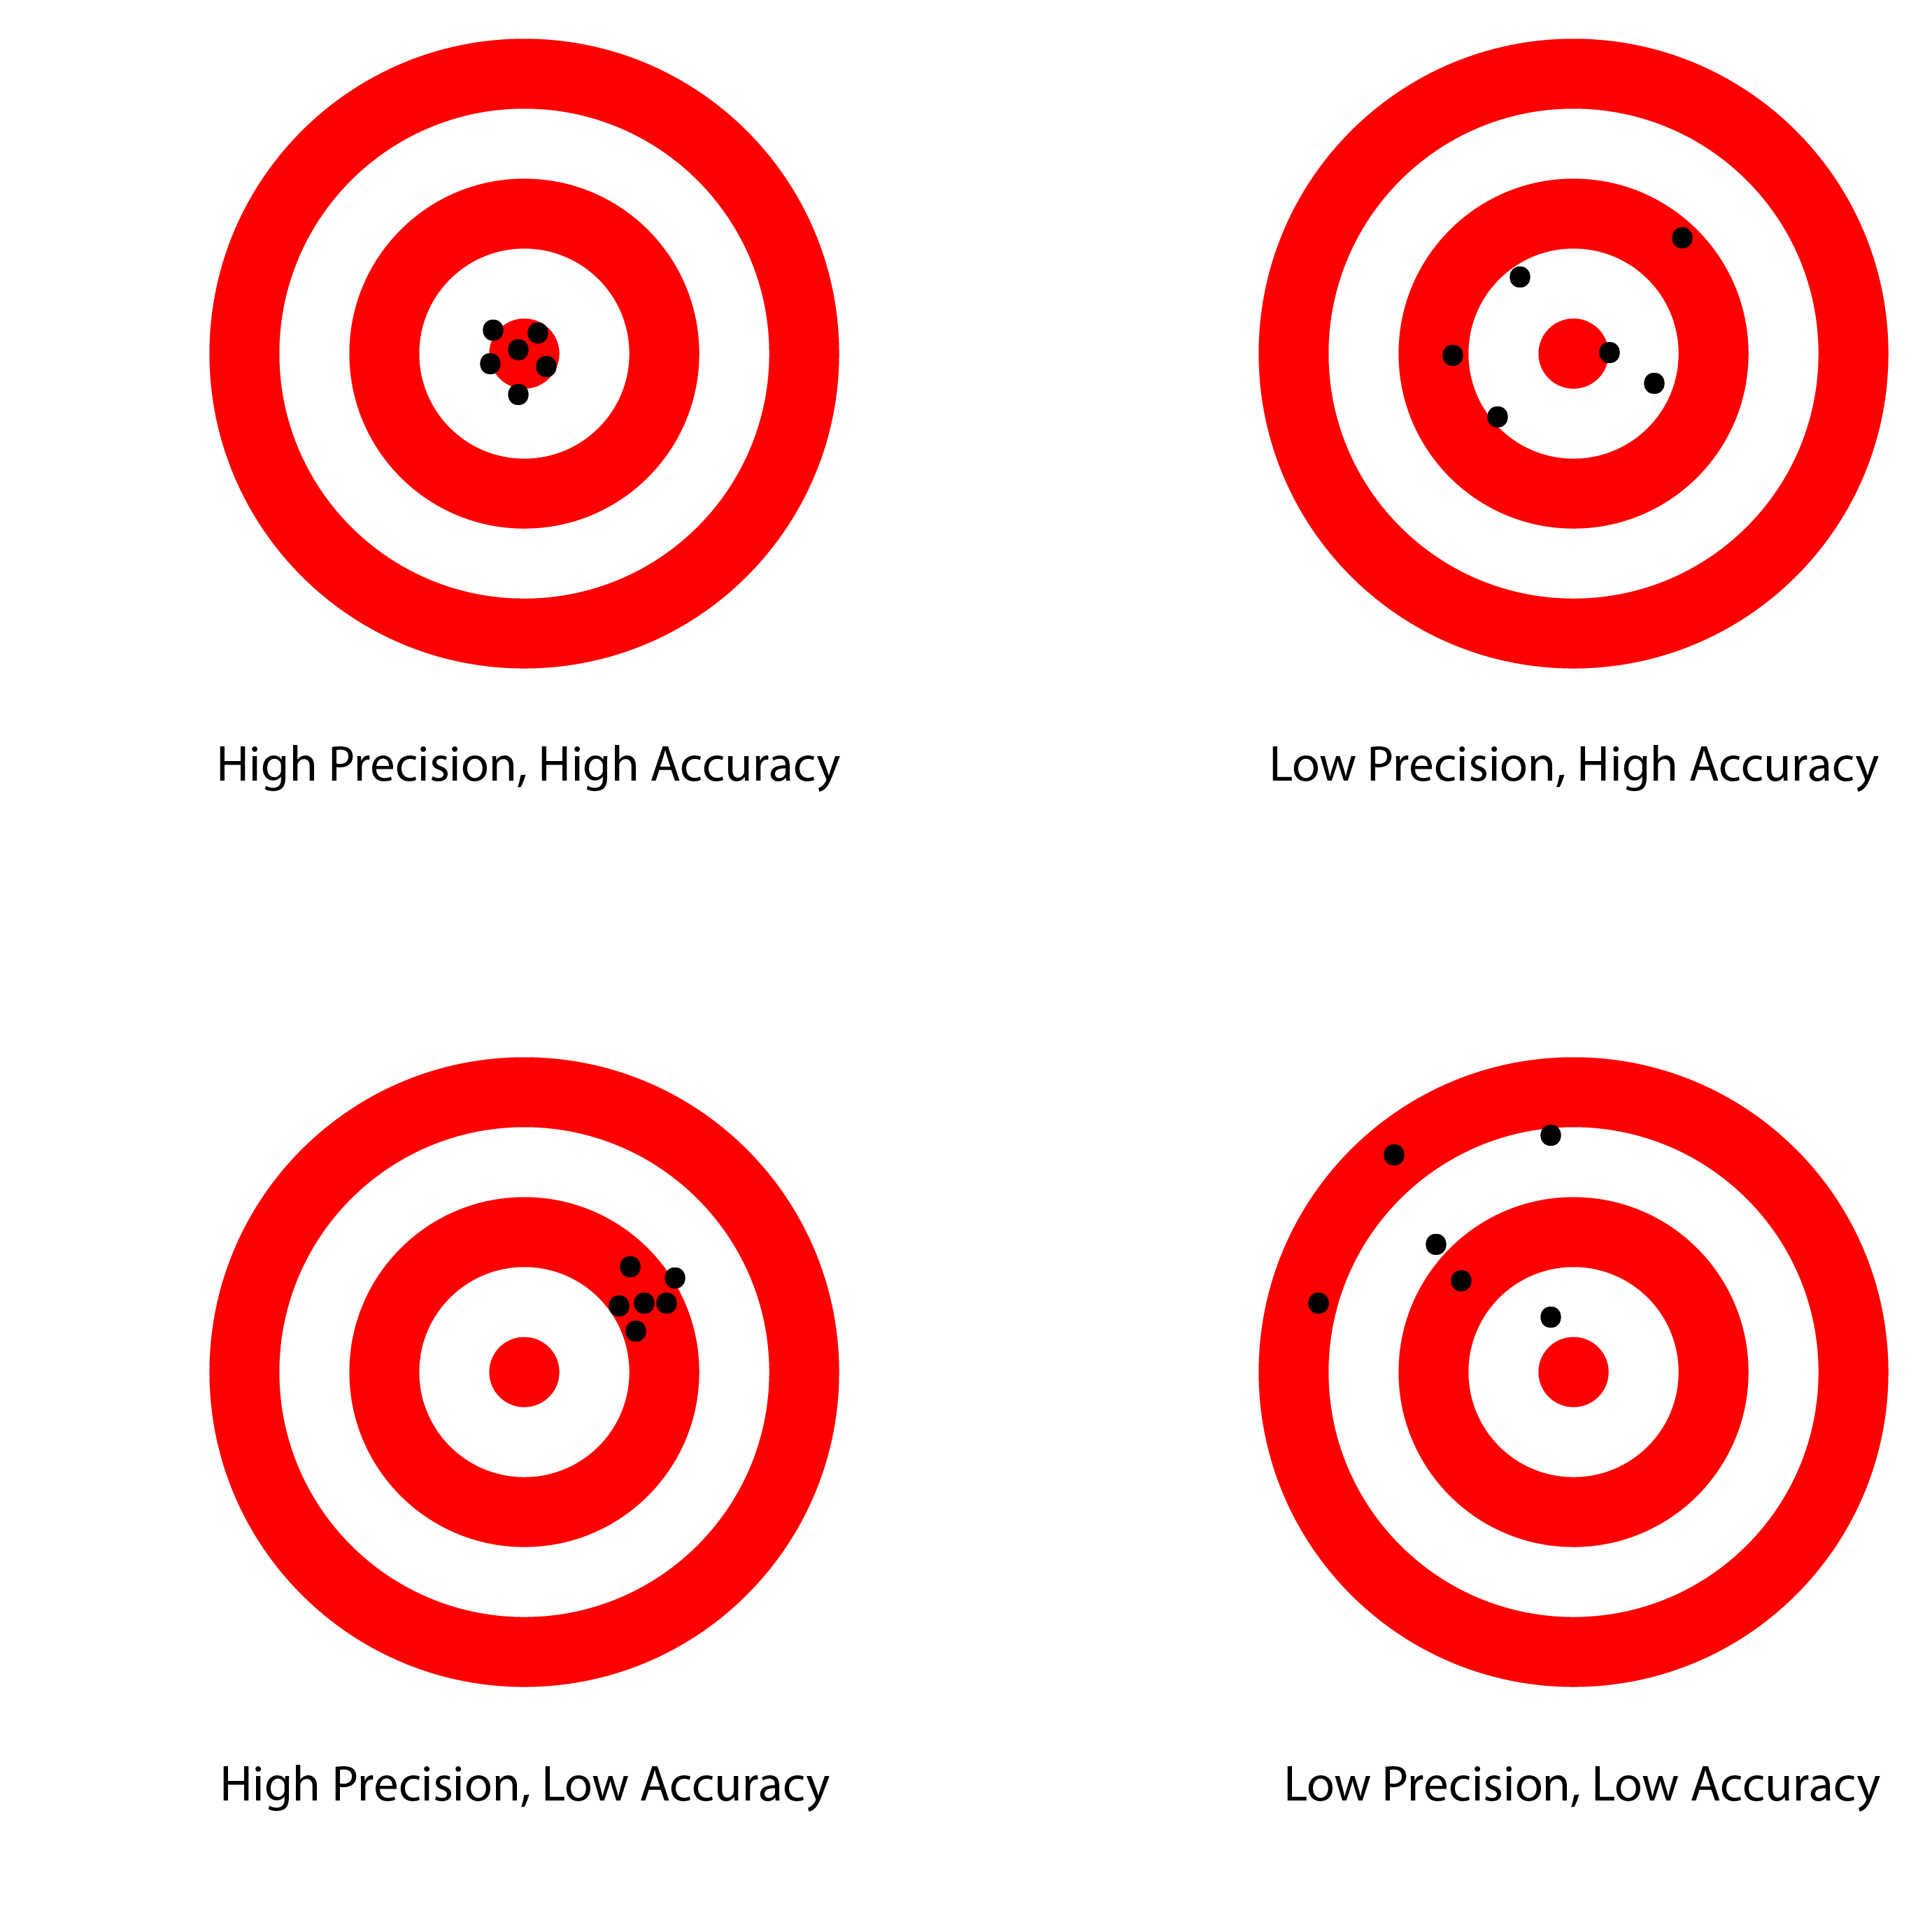
Noise- The noise will effect the result to a great extent.
Accuracy- Now a days results of MRI are not very accurate that can satisfy the doctors.

Slide 13


Slide 14
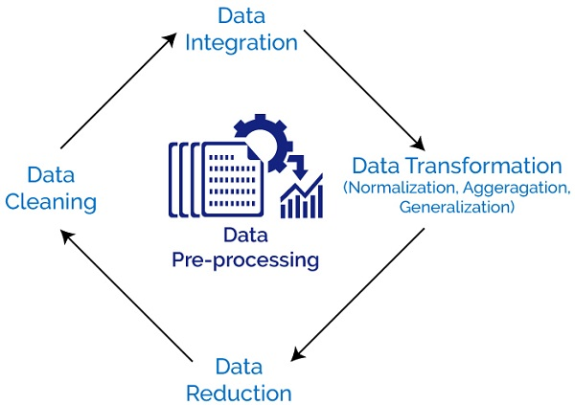
3 main stages
pre-processing
crop image based on the brain size
adjust image brightness and contrast to keep the consistency of images.
we extract the smaller image patch with the size of 25x25 for each MR image.

Slide 15

2. classification via FCNN.
Fourier convolutional neural networks

Slide 16
FCNN is proposed whereby training is conducted entirely within the Fourier domain.
The advantage is there is a significant speed up in training time without loss of effectiveness.
larger images can therefore be processed within viable computation time.
has the potential to improve the speed of any neural network system involving convolution.

Slide 17
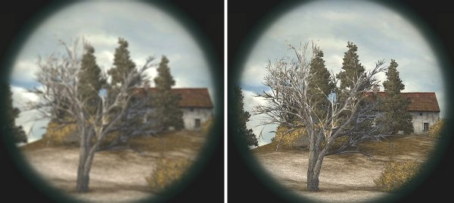
3. post-processing
Aim: Removal of clusters (specially small size ones)

Slide 18

System design

Slide 19
MRI Brain Tumour Images
Input Image
Preprocessing
Grey Scale Conversion
Contrast Enhancement
Grey image
Hybrid Segmentation
Region growing
Segmentation
Threshold
Segmentation
Segmented image
Evaluate Results

Slide 20

Implementation

Slide 21

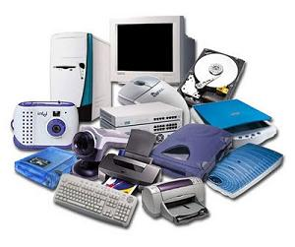
SOFTWARE REQUIREMENTS:
MATLAB is a high-performance language for technical computing. It integrates computation, visualization, and programming in an easy-to- use environment.
HARDWARE REQUIREMENTS:
Ram 4GB
Processor Core-i3
CUDA®-enabled NVIDIA® GPU with compute capability 3.0
or higher
Images of MRI scan for detection of brain tumor
64 bits OS

Slide 22


Slide 23
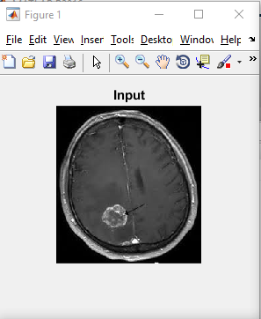

Slide 24
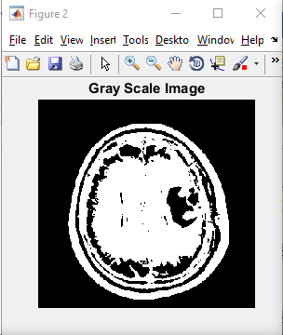

Slide 25
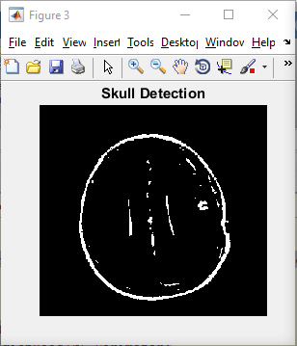

Slide 26
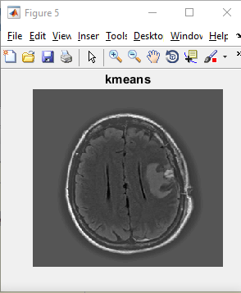

Slide 27
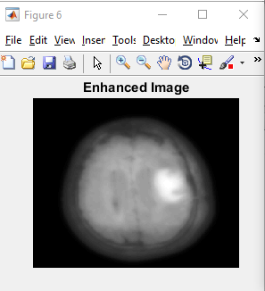

Slide 28
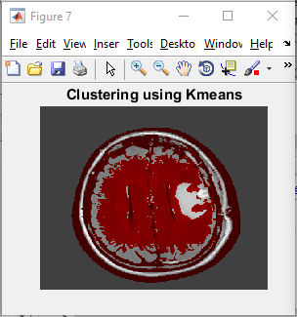

Slide 29
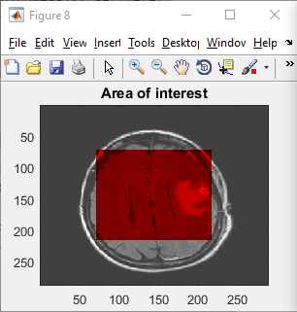

Slide 30
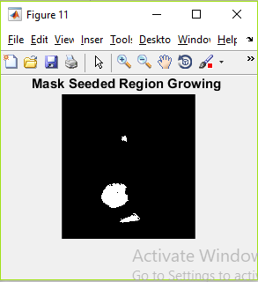

Slide 31
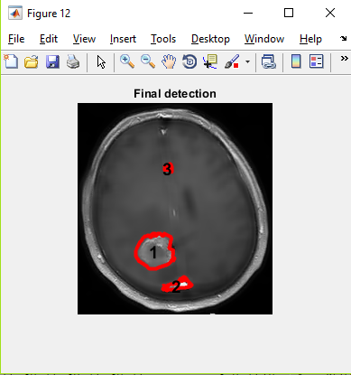

Slide 32


Slide 33
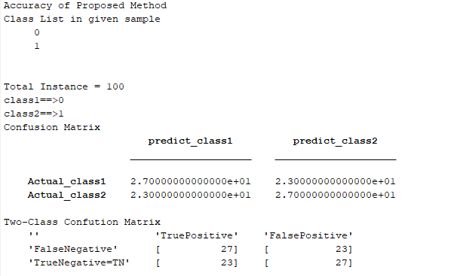
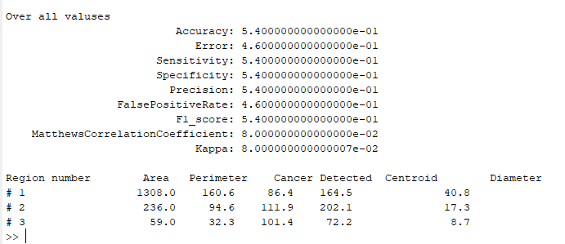

Slide 34


Slide 35
In this work, we have proposed a computer aided system for brain MR image segmentation for detection of tumor location using K - means clustering algorithm followed by morphological filtering
The proposed method has the ability to achieve higher classification accuracy and obtain a good matching rate between the segmentation result and the ground truth.

Slide 36


